Slide 1




Slide 2
FRACTALS AND SACRED GEOMETRY
FROM PLOCHER'S VITALIZING MAT
Experiment with a water drop from the tap
We observe a distinct difference in the structure of the water.
As a result of the stay on the PLOCHER pad, the tap water, traumatized by pipes, pressure and electrosmog, has structured itself into distinct geometric shapes.

Slide 3
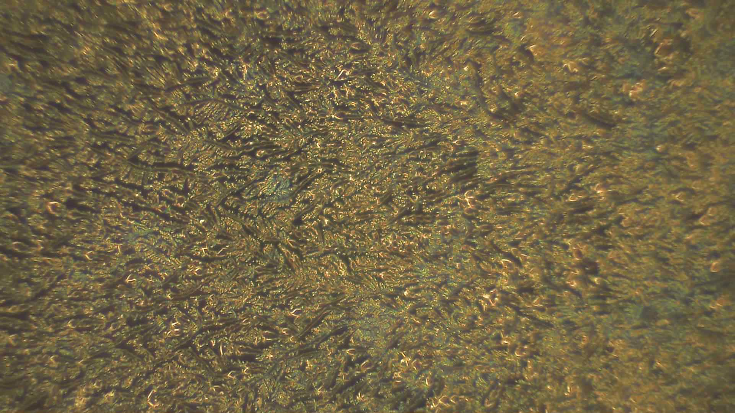
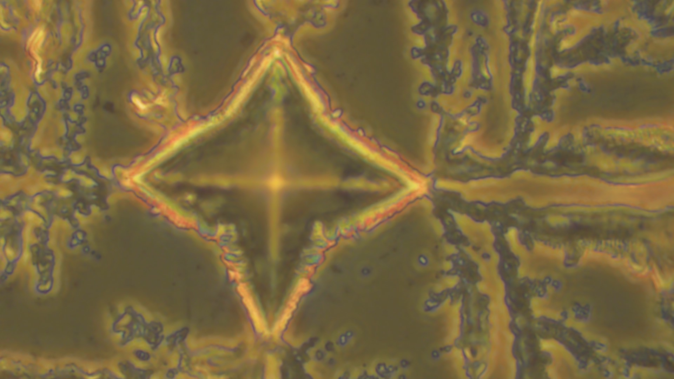
TRAUMA vs. STRUCTURE:
THE GEOMETRY OF LIFE
Control water from the tap
Tap water vitalized with PLOCHERKAT

Slide 4

Formation of vital fractals with PLOCHERKAT

Slide 5
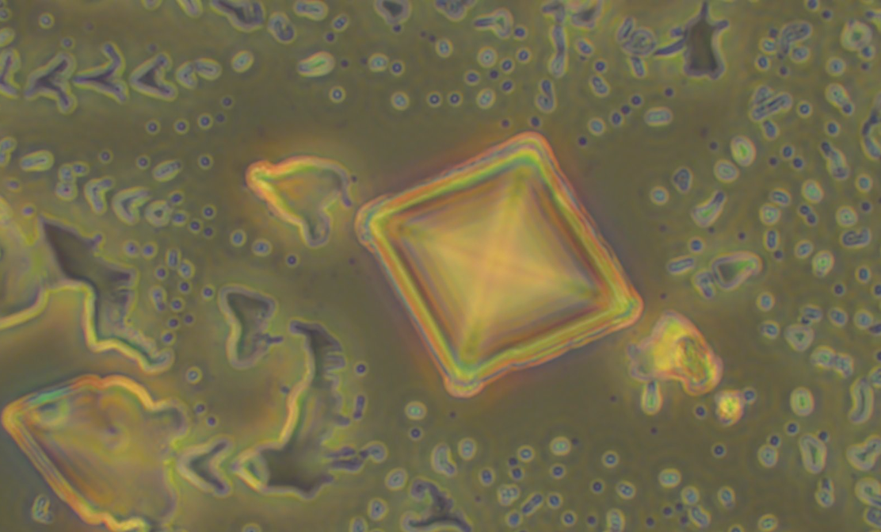
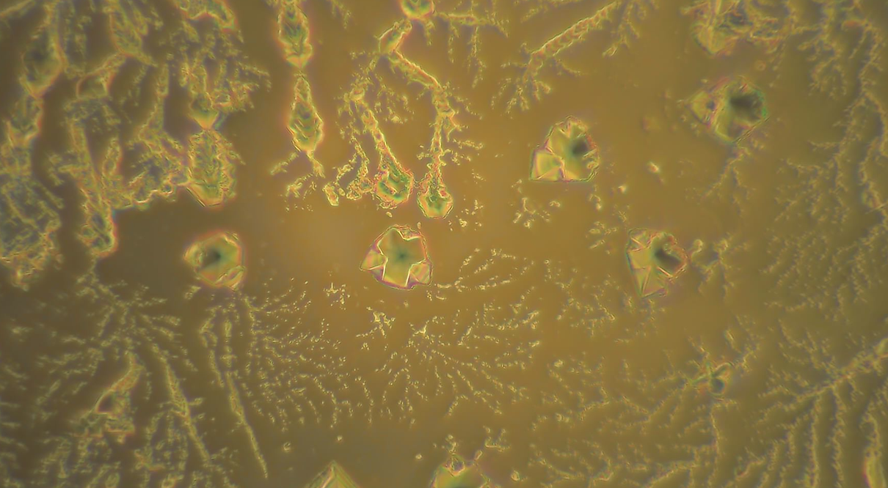
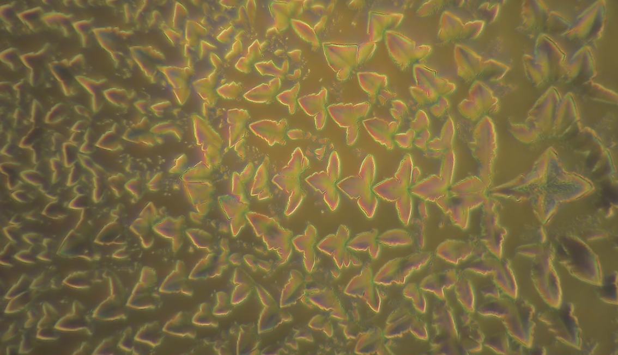
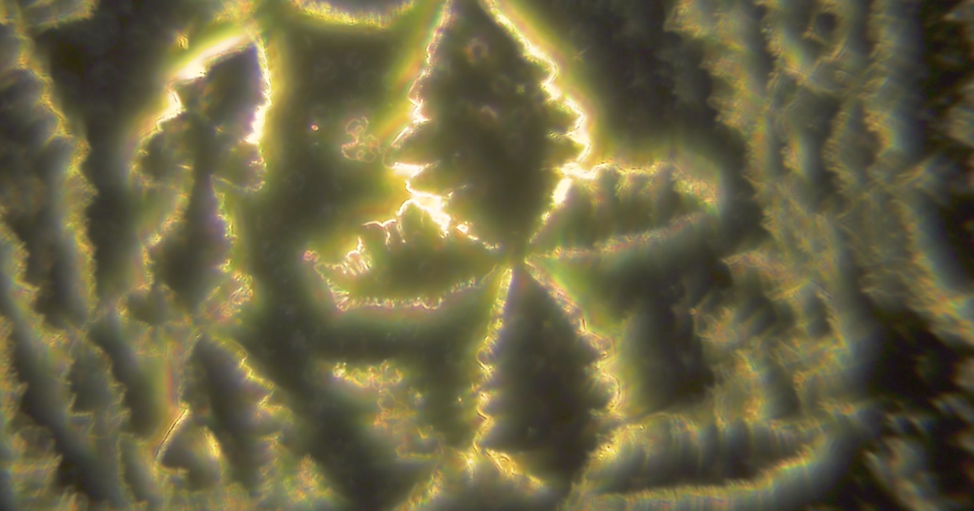
A variety of forms of vital fractals with PLOCHERKAT

Slide 6
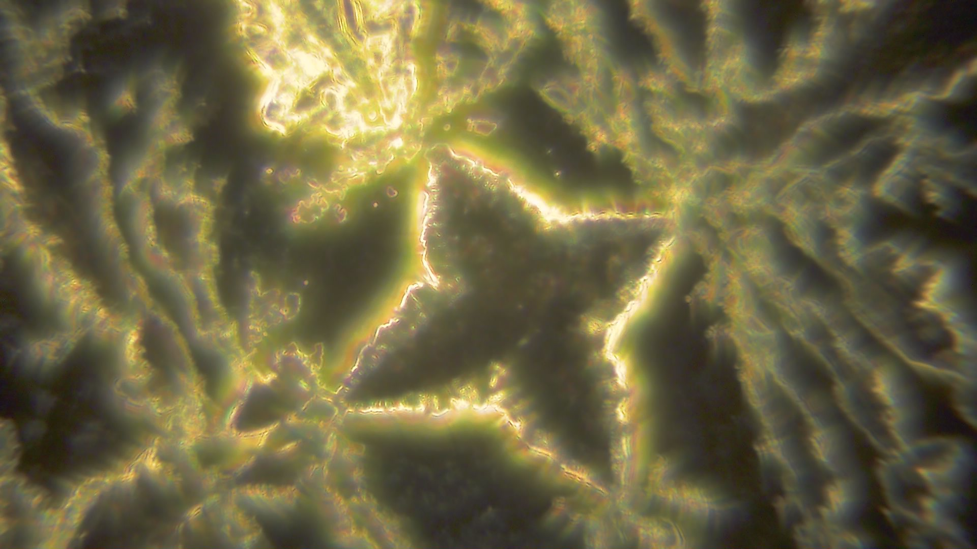
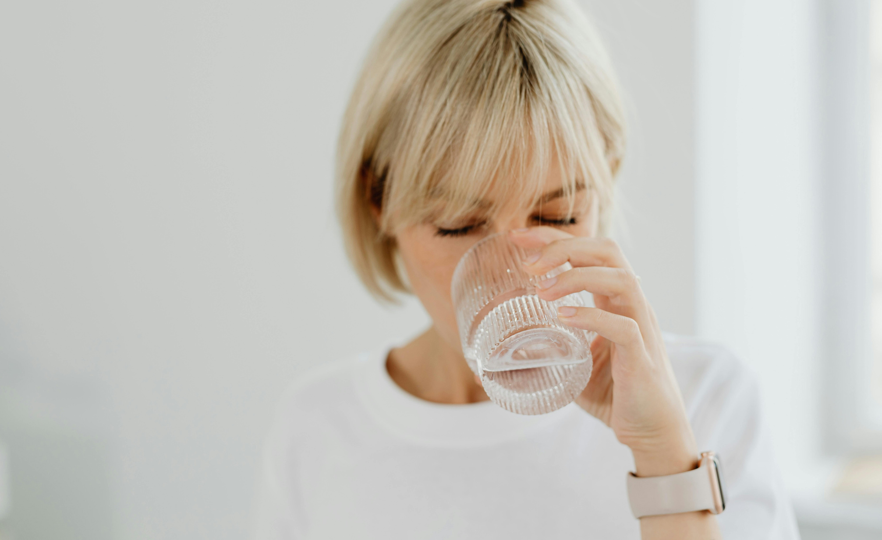
The water crystal carries the information of oxygen and spring water
We found:
Increased daily water intake
Powerful detox
Increased healthy tone

Slide 7
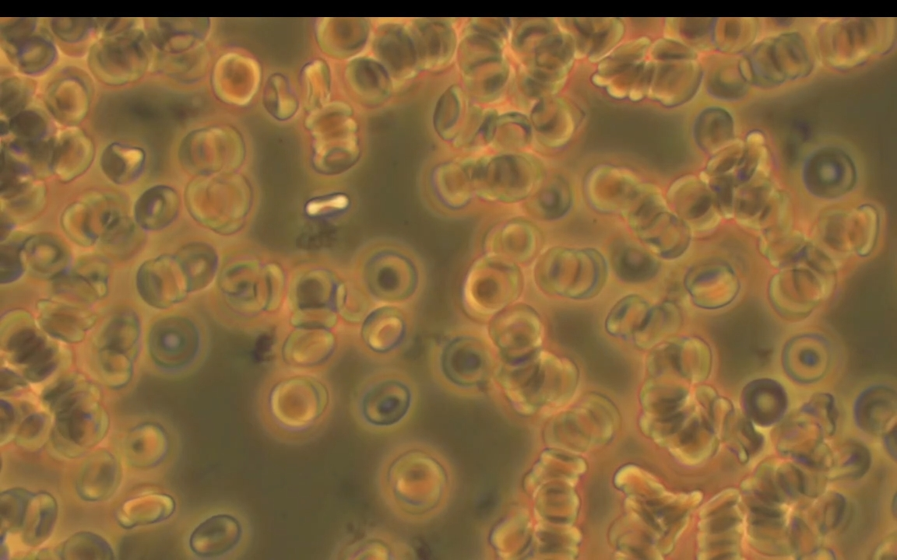
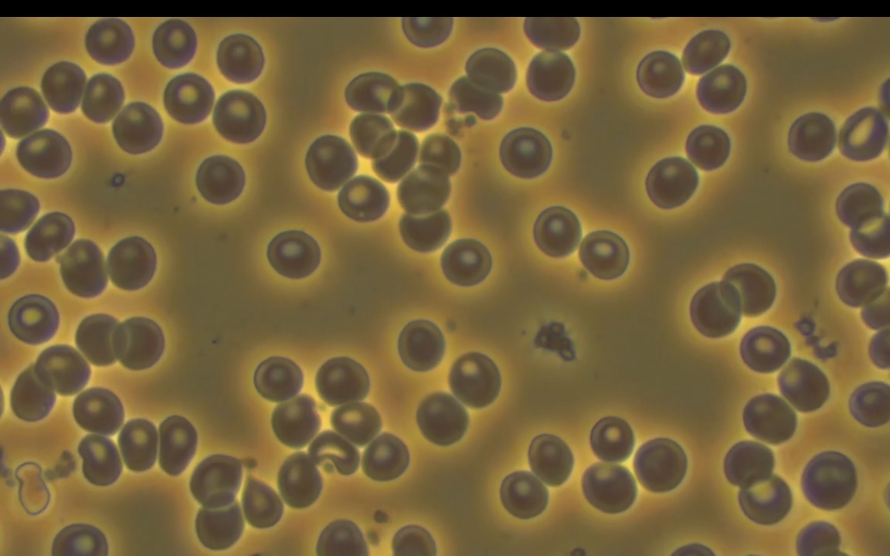
PLOCHERKAT REVIVES BLOOD
Method: Observation of a drop of living blood by oxidology
with a light microscope in phase contrast mode with 3000 times magnification.
Before the impact
Blood taken after an hour and a half of stressful driving demonstrated loss of vitality, impaired rheology and pronounced erythrocyte aggregation. The subject experienced increased excitability and fatigue.
After the impact
The subject was treated with PLOCHERKAT small – applied to the area of ​​the left hand.
We observed significant changes.

Slide 8
Erythrocytes in aggregation before exposure to PLOCHERKAT

Slide 9
Restored erythrocyte vitality after exposure to PLOCHERKAT

Slide 10
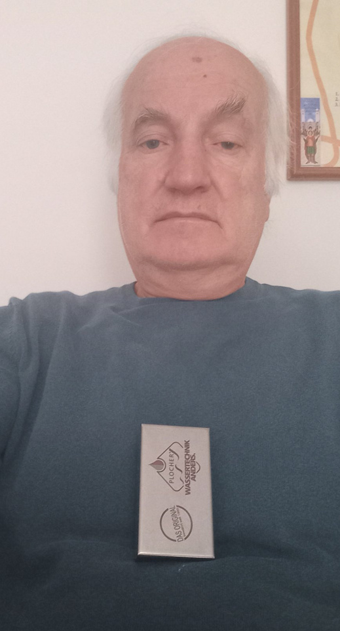
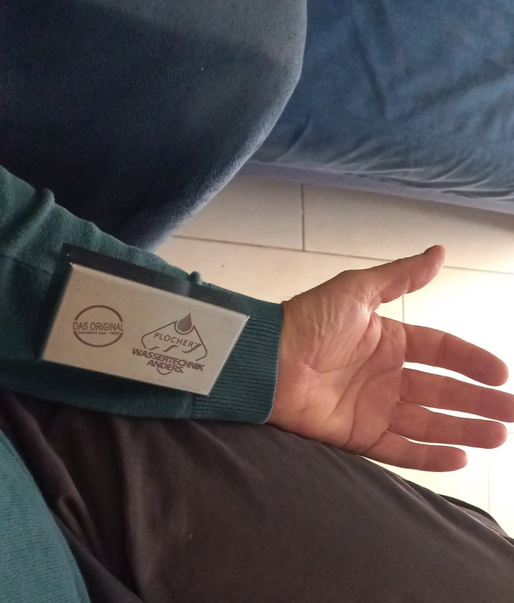
PLOCHERKAT IMPROVES
HEALTH CONDITION
Before the impact: Blood pressure during traffic tests was increased by 10 units above normal – 132/89.
PLOCHERKAT mini was used,
applied for 15 minutes to the heart area
and 5 minutes to the left arm.
After the impact: Permanent normalization of
the blood pressure to 121/80.

Slide 11
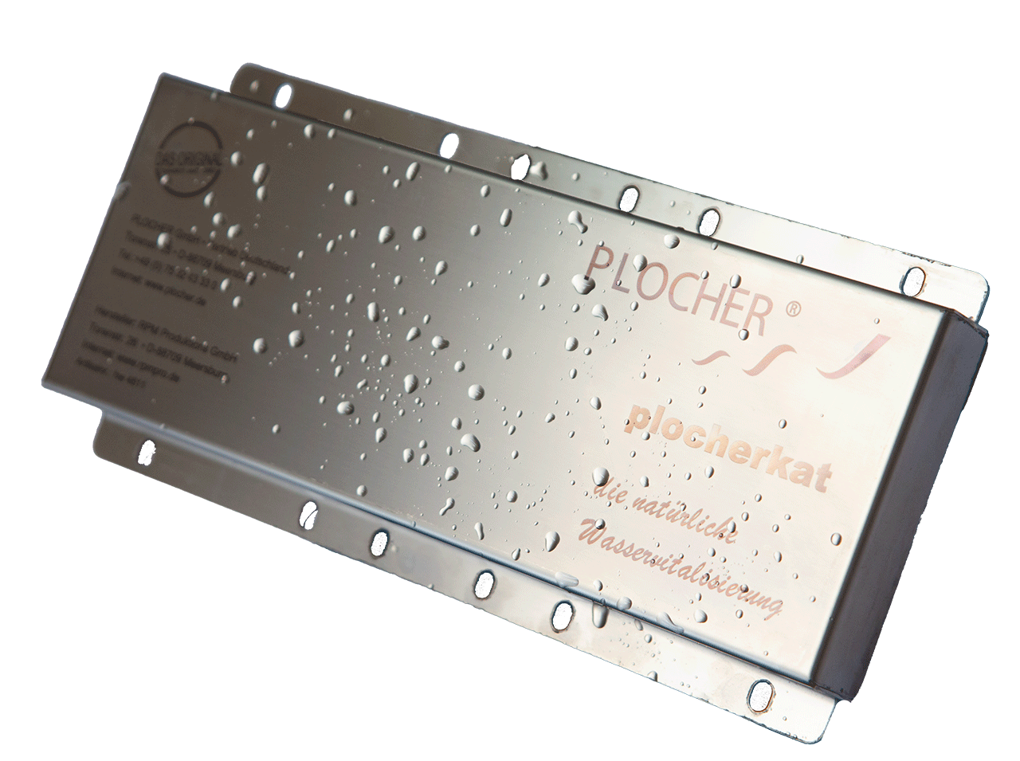
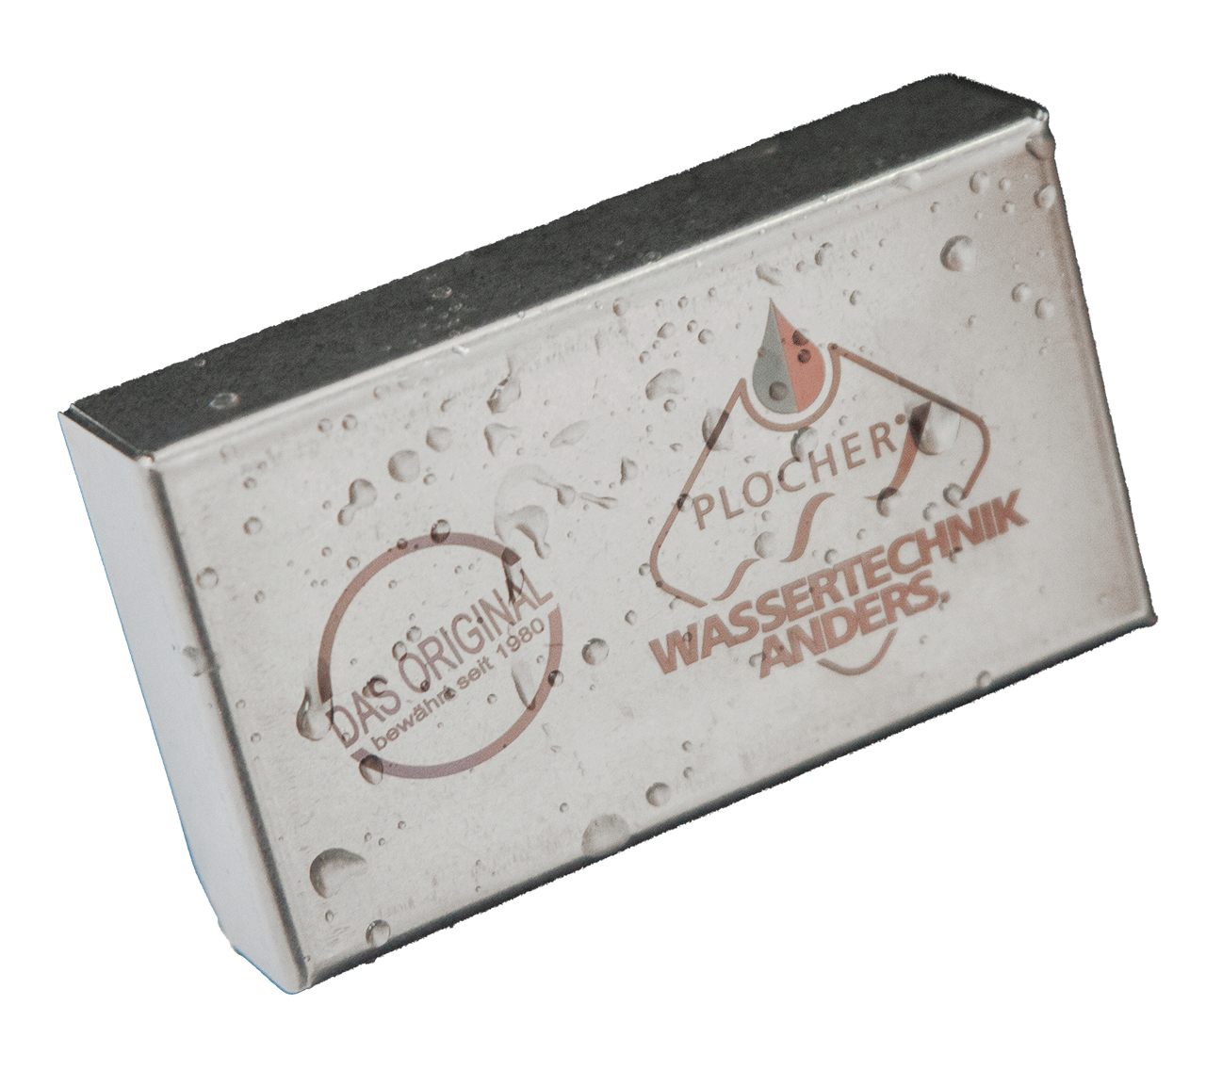
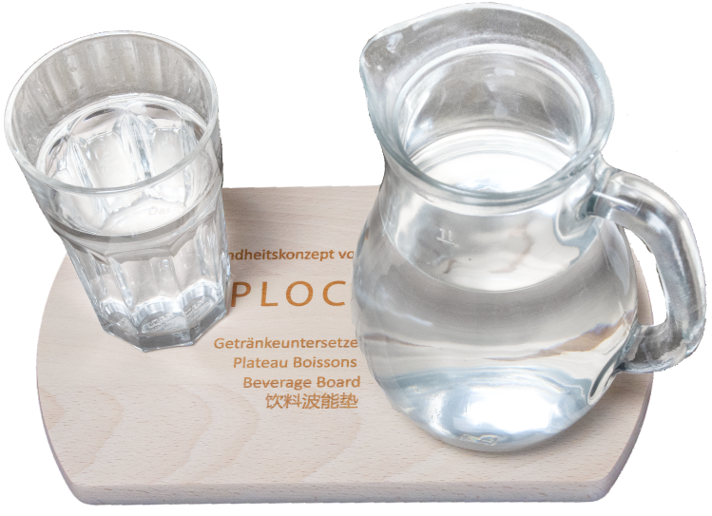
RESULTS OF THE RESEARCH CONDUCTED
WITH PLOCHERKAT
Full hydration of organisms
by increasing daily water intake.
Effective absorption of minerals
that become in ionic form, as part of the water.
The beneficial influence of PLOCHERKAT devices as free energy technology for the health of plants, animals and humans.

Slide 12
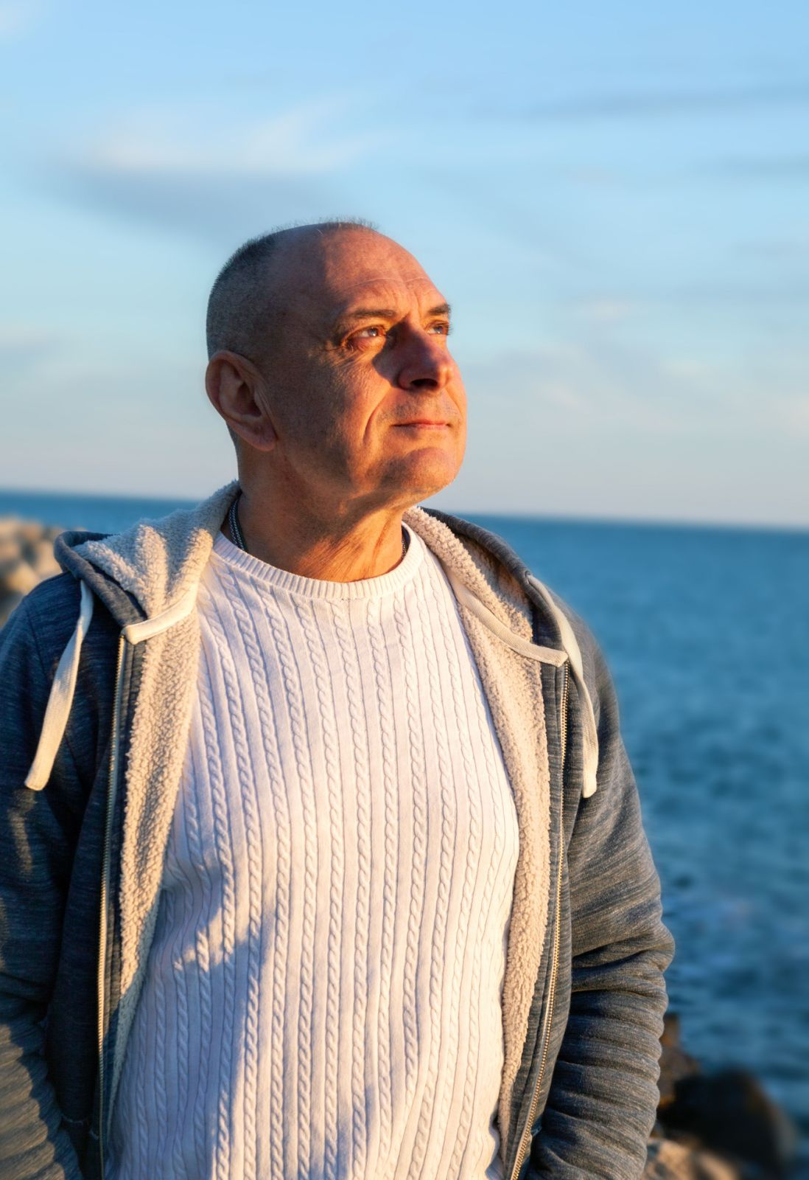
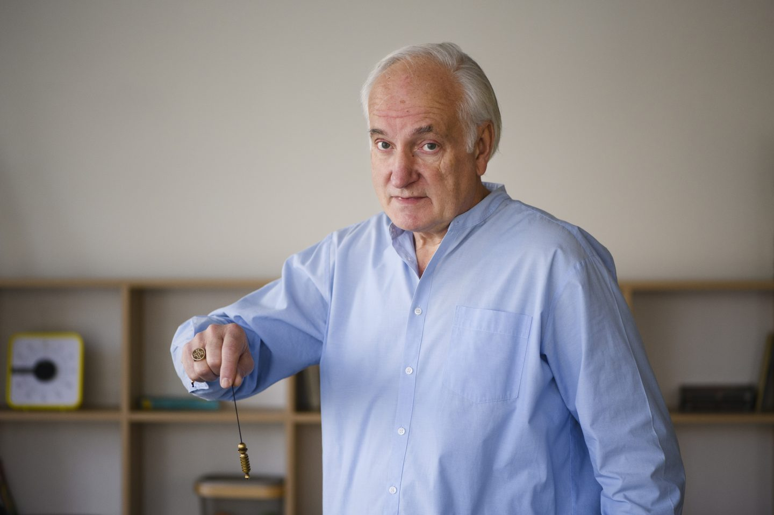
Invisible action,
visible results with PLOCHERKAT
© Plamen Asparuhov –
researcher and manager of
„Bio Blagodat“ EOOD, 2025
© Ivan Todorov – researcher, dowser and expert in complex systems, 2025

